Slide 1
Notes from Rob and Gregory
Make the Product item hierarchical instead of the Model item
Leave Model as relationship item (relationship to null)
Model is equivalent to SKU.
Model has the volume forecast information and effectivity information
Consider separating the MUE from Portfolio revenue forecast for simplicity
Model Form will have property→Part this is a 1:1 relationship
Make Effective_Date editable on Model Form for controlling effectivity without a ECN.
Make model versionable (needs testing as a relationship instance)
Model Lifecycle will need Released state(s) for Effective_Date to work.
Where-used will be fixed in 8.2.1 and higher, so that Model WU leads to Product
MODEL - need to decide whether Model has a property pointing to part, and Model is versionable, versus Model is not versionable, and has a relationship to Part, and on this relationship is effectivity information (see next slide)

Slide 2
Notes
Leave Model as relationship item (relationship to null) vs convert to an Item
Make model versionable (needs testing whether this works as a relationship item instance)
MODEL - need to decide whether Model has a property pointing to Part, and Model is versionable, versus Model is not versionable, and has a relationship to Part, and on this relationship is effectivity information.
Model v10
Model v10
Part v10
Model v10
Part v10
Model v10
Part v10
Part v10
Model
Model-Part
Relationship
Part v10
Model-Part
Relationship
Part v10
Model-Part
Relationship
Part v10
Model-Part
Relationship
Part v10

Slide 3
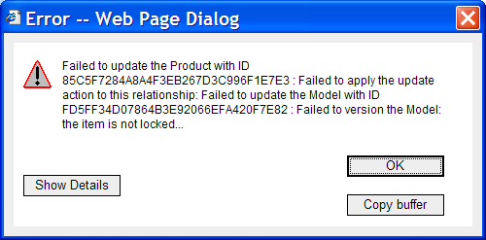
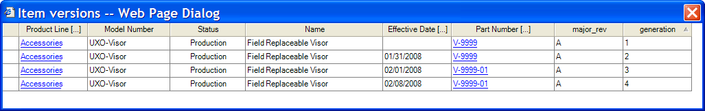
Prototype
Leave Model as relationship item (relationship to null) vs convert to an Item
Make model versionable
Add a Model form
Add a Model lifecycle Idea->Development->Production->Obsolete
Change Model Item
add forecast relationship to null
change default lifecycle to new Model lifecycle
add view to the new Model form
PROBLEMS:
Model Lifecycle does not match the PE pattern, so the PE Promotion method fails
To use Effective_Date, the Model also has to be Is_Released.
When Product is locked, and Model tab is open, it is possible to edit the Effective_Date property, but this cannot be saved. Because Failed to Version to Model – it’s not locked.

Slide 4
Product-Model-SKU Package
Requirements
Need structure and where-used to work: Product → Model → Part. Currently where-used does not explore up to Product.
Model needs hierarchy to create real catalogs. A given company will have products with differing depth in Model’s. (see examples at end)
Product and Model items need additional properties, and links to Files to allow creation of a catalog
Don’t have an obvious SKU in the current data model
A part can be pointed to by many SKU’s (same spare kit used in many models).
SKU needs forecast information for Portfolio Management (volume, unit cost and unit volume)
Pricing information on SKU will need multiple currencies
SKU needs link to Idea, Project and Part for Portfolio Management of new vs. existing product lines
Model or SKU needs Units for Model-Unit-Effectivity
Model or SKU needs a link to Part that is controlled by ECN, so that engineering can roll part numbers, and separately an ECN is used to point SKU to the new part. Affected items should include SKU as a controlled item.
9 + 10 imply that the relationship from SKU (Model) to Part is either Date Effective or Unit Effective
Also should support Floating link to Part latest released revision for companies that want less control
SKU # should be enforced Unique
Model & SKU do not need history (versions). Except may have some history if we implement Units (MUE)
SKU → Part is 1:1 at any point in time, but with date-effectivity and unit-effectivity there may be multiple SKU to Part relationship instances, business logic decides which single instance is used.

Slide 5
Product-Model-SKU Package - Alternative #1
Product Line
name
description
state {active, obsolete}
file (s)
ECR
Affected Items
name
description
File (s)
status {active, obsolete}
Model
Document
1:1
Part
Item_number
name
description
state {idea, project, production,
cancelled, obsolete}
SKU
Forecast
period
volume
unit cost
unit revenue
Notes:
Simplest model – default UI works. Where-used and Structure work
Model-Unit-Effectivity not covered.

Slide 6
Product-Model Package - Alternative #2
ECR
Product Line
name
description
state {active, obsolete}
file (s)
Affected Items
Model
name
description
File (s)
status {idea, project, production,
cancelled, obsolete}
1:1
Part
Document
period
volume
unit cost
unit revenue
Forecast
Notes:
SKU and Model are the same thing. Might want a classification so that catalog printing and other behaviors know the difference. If SKU, should have no further Model Structure.
This model is simpler for MUE

Slide 7
Product-Model Package – Alternative #3
ECR
Product Line
name
description
state {active, obsolete}
file (s)
Affected Items
Model
name
description
File (s)
status {idea, project, production,
cancelled, obsolete}
Effectivity
Forecast
Part
Document
Period: from date – to date
Range/Volume: from unit – to unit
unit cost goal
unit revenue goal
Notes:
SKU and Model are the same thing. Might want a classification so that catalog printing and other behaviors know the difference. If SKU, should have no further Model Structure.
Have merged MUE (link from Model to Part) and forecasting. The relationship has from_date and to_date, and from_unit and to_unit, along with revenue and cost goals. We can create different wizards/dialogs for editing the forecast information to simplify data entry depending on which model is being used (date effective, MUE, or no effectivity implied, just revenue forecasts)

Slide 8
Product-Model-SKU Package - Examples
PRODUCT | MODEL / SKU | MODEL / SKU | MODEL / SKU | MODEL / SKU | PART (engineering)
Running Shoes | Omni | Size 10 |  |  | 100-0001
 |  | Size 11 |  |  | 100-0002
 |  | Size 12 |  |  | 100-0003
 | Speed | Size 10 |  |  | 100-9001
Bomb Suits | Military | Helmut | XL |  | 400-0001
 |  |  | XXL |  | 400-0002
 |  | Suit | Small |  | 500-0001
 |  | Accessories | Visor |  | 600-0090
 | Police | Helmut | XL | English Docs | 400-0011E
 |  |  |  | French Docs | 400-0011F
 |  |  | XXL | English Docs | 400-0012E
 |  |  |  | French Docs | 400-0012F
 |  | Accessories | Visor |  | 600-0090
Notes:
Cell with blue-background is the SKU
Only the lowest level in the Model structure has a link to Part(s). Either a Part property, or if we support Effectivty, a relationship to Part with effectivity on the Link.

